Slide 1
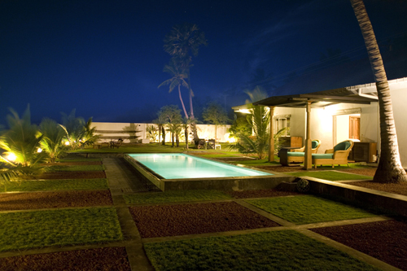
Welcome to Kalpitiya

Slide 2
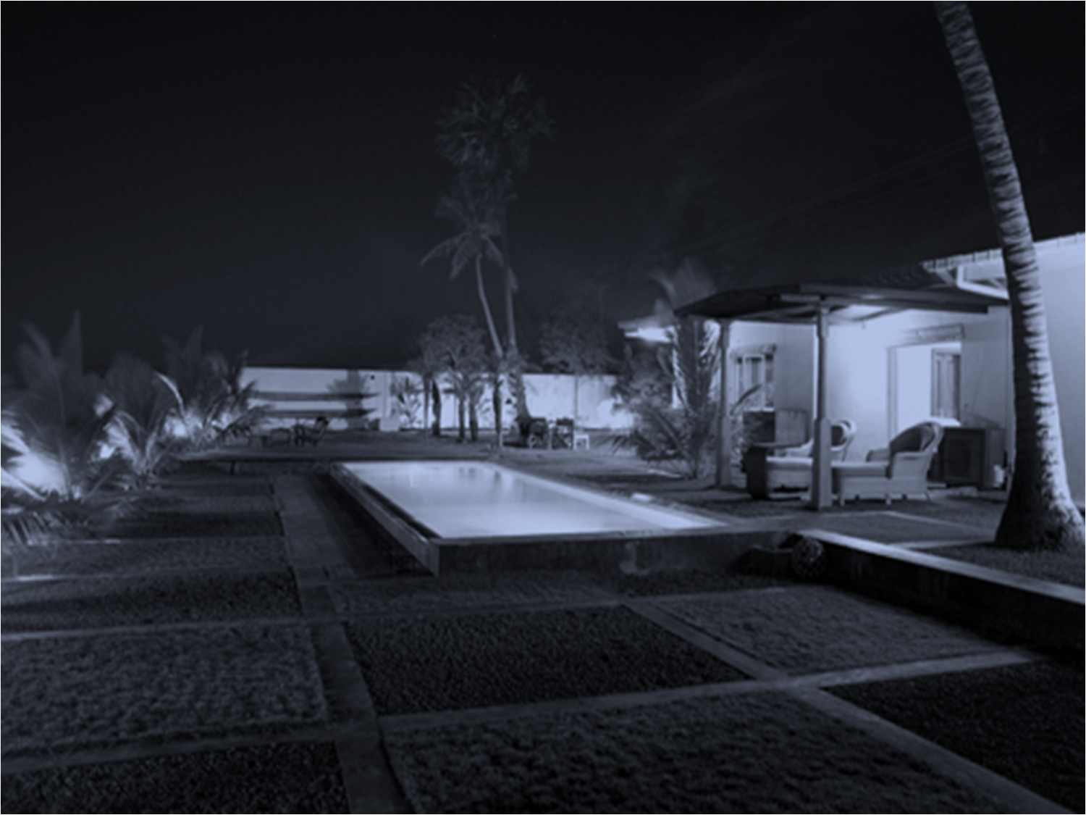
Welcome to Kalpitiya
A natural hot spot and a fascinating historic Dutch maritime town
An amazing re-construction marvel
of an old boat yard turned in to
an elegant bungalow with heavenly comforts.
An arcihitect designed, brand new,
spacious and fully furnished bungalow on 1 acre of land,
with an extensive garden and a view of the lagoon,
situated in the Palavia/ Kalpitiya road 200m away from Palakuda junction.

Slide 3
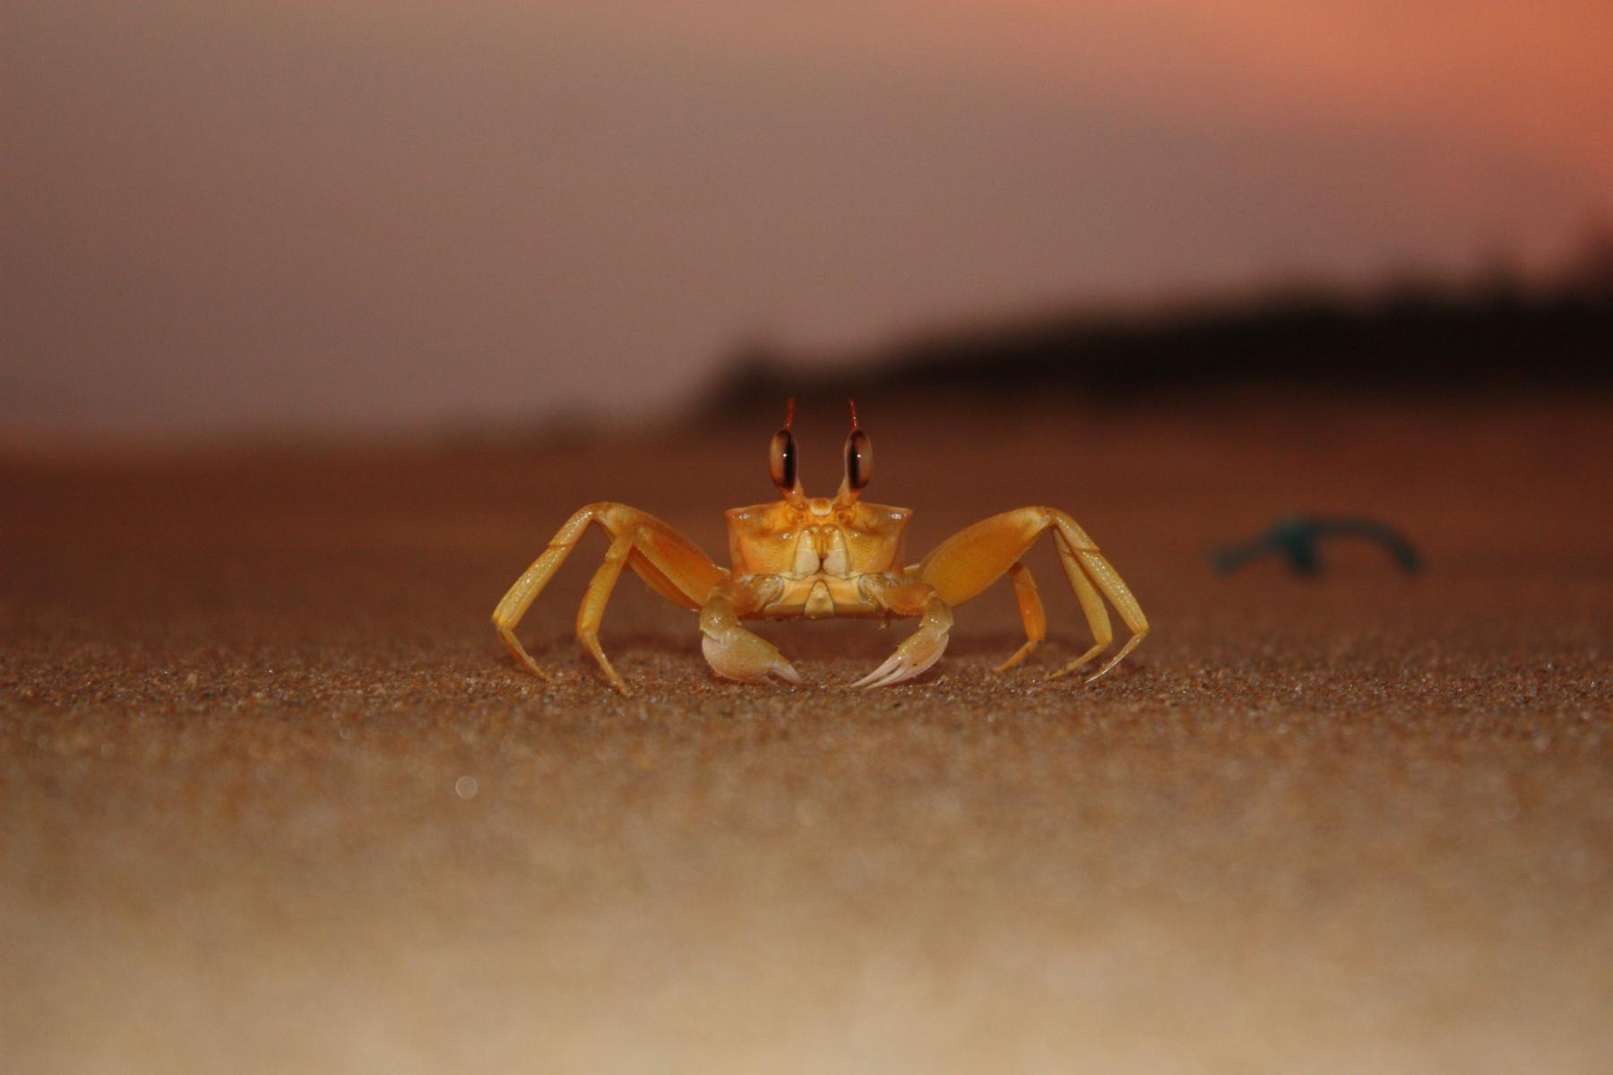
Experience life…………
Explore the beauty of the amazing Dutch Town.
Taste the aromatic sea food dishes
straight from the lagoon
while enjoying the
sights & sounds of friendly Dolphins

Slide 4
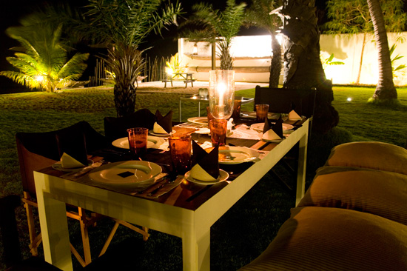
Dine luxuriously
outdoors

Slide 5
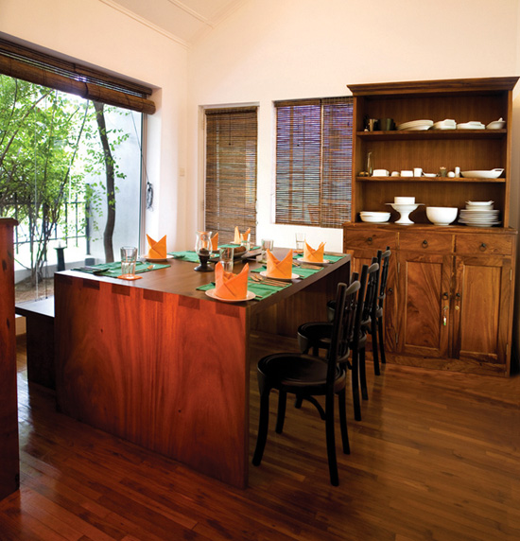
Dine luxuriously
indoors

Slide 6
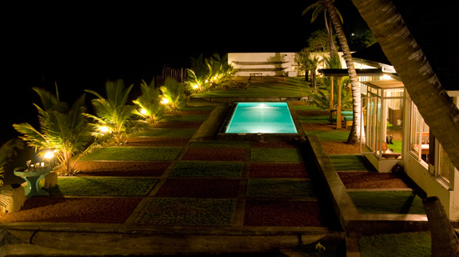
Experience the art of living
Open your bedroom doors
and enjoy the breath taking views of the Kalpitiya lagoon,
where age old traditions
continue to this day.

Slide 7
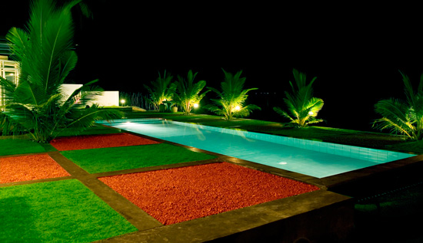
Take a dip in you pool and relax

Slide 8
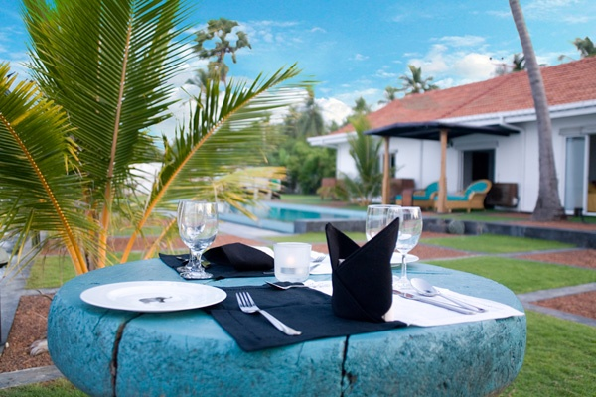
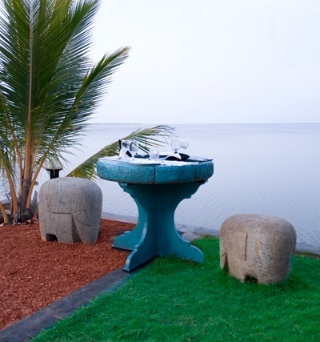
Enjoy a cup of cappuccino
while gazing over the horizon

Slide 9
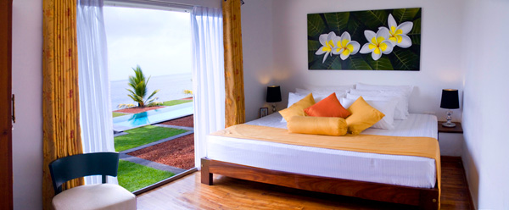
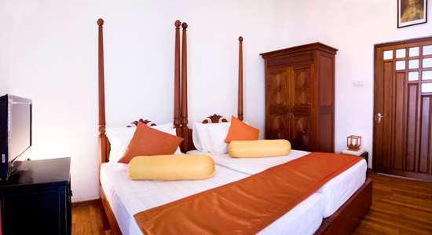
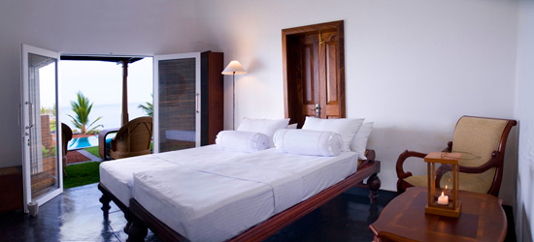

Slide 10
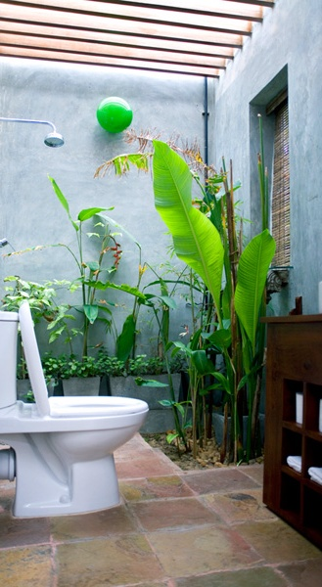
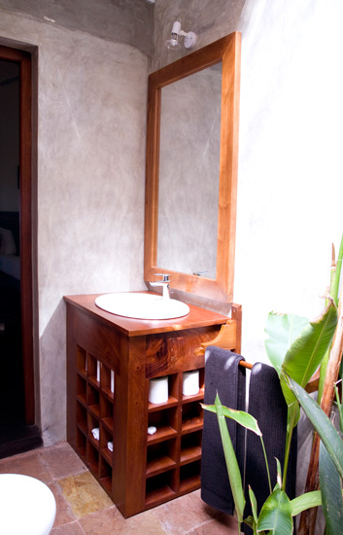

Slide 11

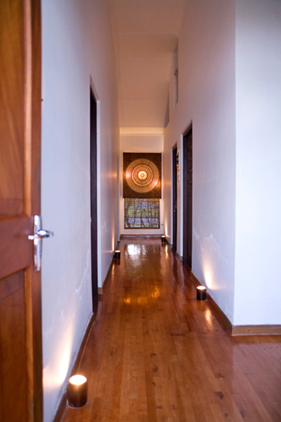
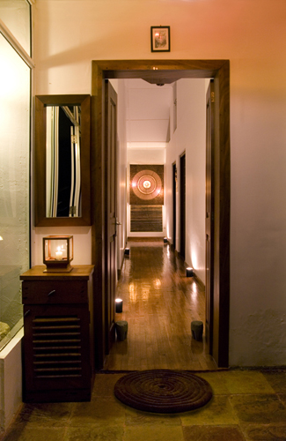

Slide 12
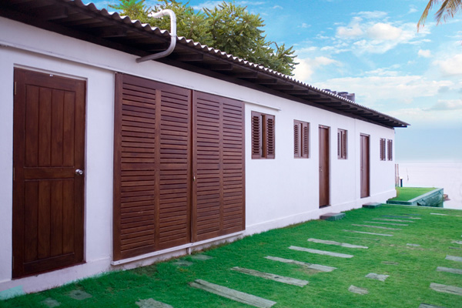

Slide 13

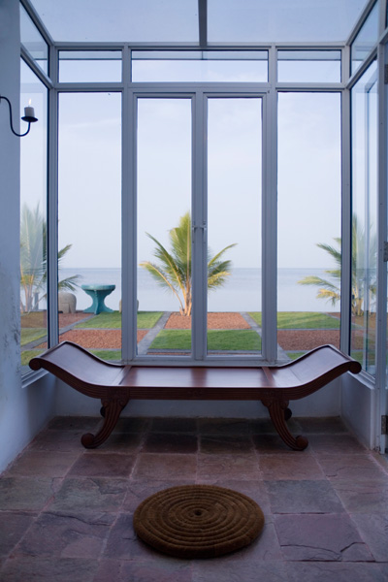
Panoramic view of the
Beautiful sea

Slide 14
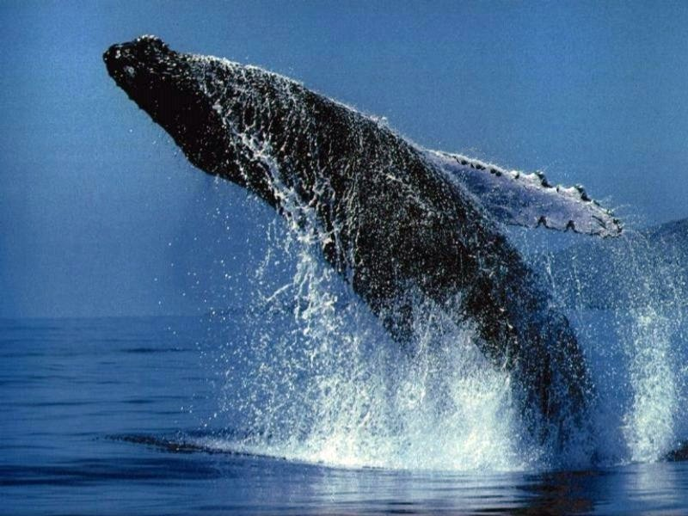
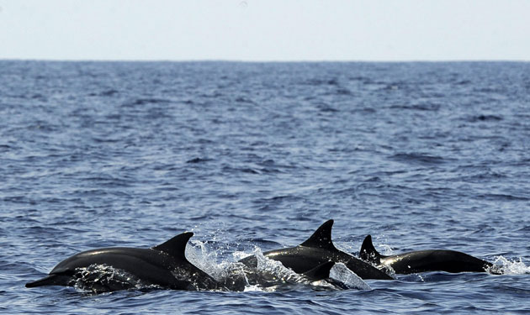
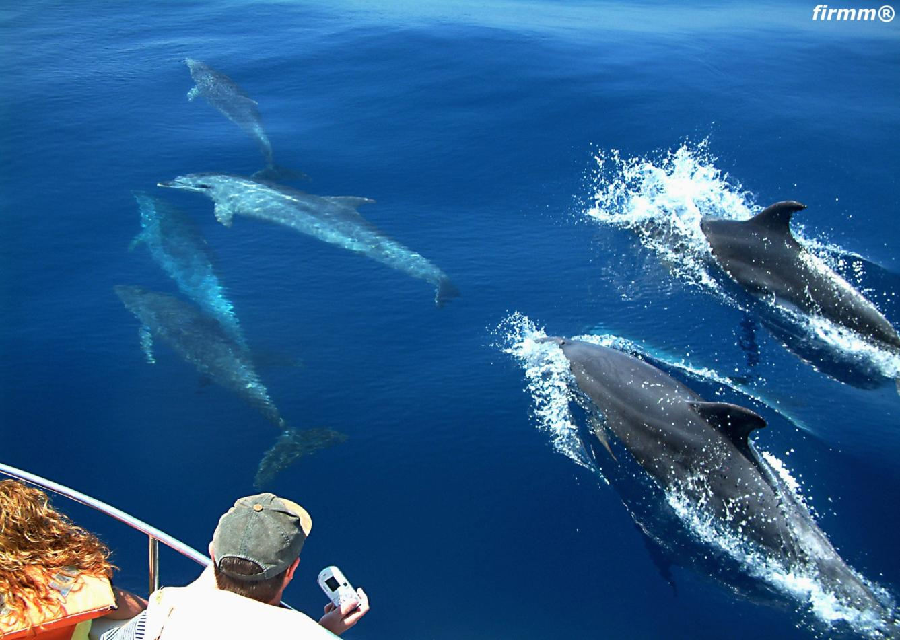
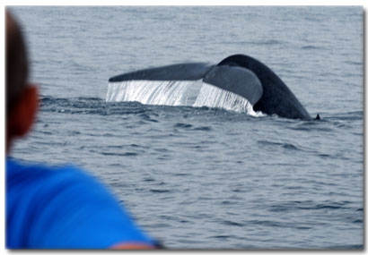
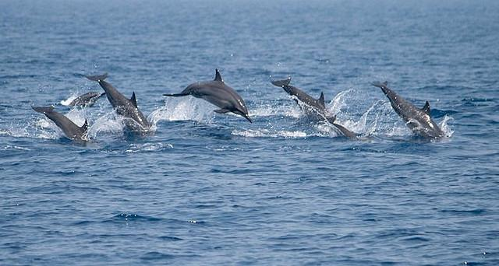
Whale watching
Dolphin watching

Slide 15
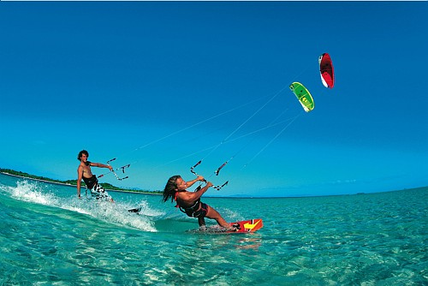
Finally…… enjoy a session of
Kite surfing

Slide 16
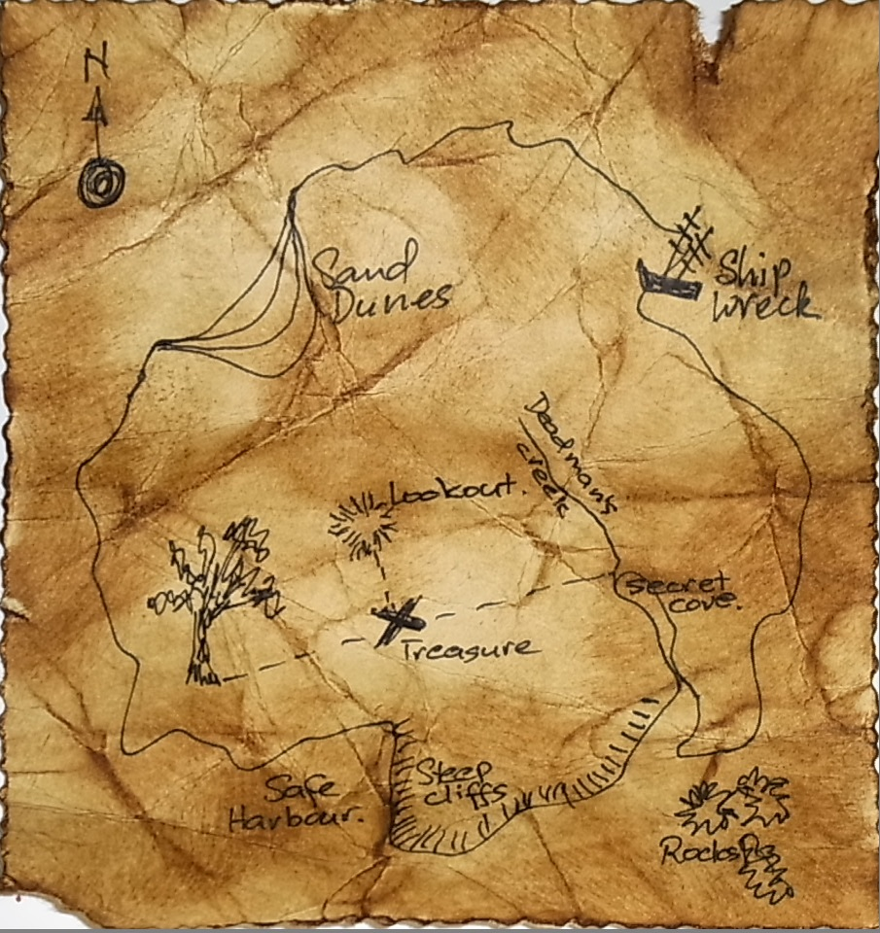
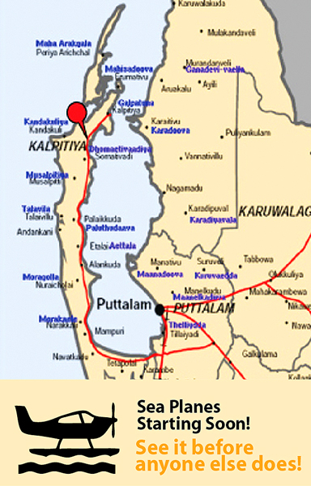
All this & more
can be found at

Slide 17

Call today
+94 -777 - 004 999

